Slide 1
Office of Informatics and Analytics (OIA) Strategic Investment Management (SIM) Business Architecture (BA)
VHA Business Information Architecture,
How VHA Business Information Architecture Leverages and Contributes to the Federal Health Information Model

Slide 2
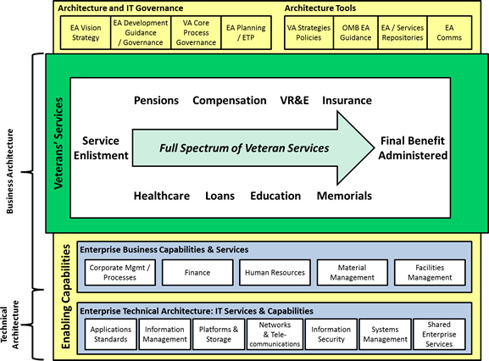
BA Overview Brief: Health Segment Architecture
In accordance with Federal CIO Council guidelines, VHA Business Architecture is a contributor to the overall OneVA Enterprise Architecture
Health
Business Architecture
VA Health Segment Architecture
Federal Enterprise Architecture
OneVA EA Content Scope
Technical Architecture
The Department of Veterans Affairs follows the Federal Enterprise Architecture Framework. The VA Enterprise Architecture is comprised of several architecture segments including the Health Segment Architecture
The Health Segment Architecture is comprised of two components:
Health Business Architecture—developed by VHA Strategic Investment Management Business Architecture
Technology Architecture—developed by the VA Office of Information and Technology (OIT)
Notes:
2
Note: This slide was last updated on October 22, 2013.

Slide 3
BIA Overview – BA Organization and Responsibility Chart
Director,
Business Architecture
Steve Taaffe
Deputy Director,
Business Architecture
Ian Komorowski
Admin: Rosetta Brammer
Operational Architecture Services
Yolunda Coleman-Dews
Chief Architectural Advisor
Bob Bishop
Budget and Planning
Communications and Marketing
Compliance and Configuration Management
Contracting
Performance Management
Repository
Staffing
Training
Health Segment Architecture (HSA) management
Technical leadership and architectural development oversight
Business architecture frameworks and best practices consultation
FEA, FHA, IT, and health care architectural compliance
Federal Space Outreach and Interactions
Planning and Integration
Architecture
Tom Henry (Acting)
Strategic and Performance
Architecture
Jim McDearmon
Business Reference Architecture
Donna Marcum
Business Process Architecture
Tammy Talley
Business Information Architecture
Linda Drummond
Business Architecture Specification Report (BASR)
Business Architecture Tactical Action Plan / Assessment
Business Architecture Integration Methodology / Integrated Architecture Tooling Solution Metamodel
Health Information Strategic Plan
VHA Strategic Architecture
VHA Performance Architecture
Strategy/Performance Architecture Metamodel
VHA Business Reference Model (Business Function Framework)
Business Architecture Repository (BAR)
Integrated DoD/VA Business Reference Model (iBRM)
Business Reference Architecture / Business Architecture Repository Metamodel
VA/VHA Business Process Models and Process Modeling Summary Reports (PMSR)
Business Process Architecture Metamodel
VA/VHA Information Models and Information Modeling Summary Reports (IMSR)
Information Domain Models
Business Information Architecture Metamodel
Notes:
Linda Drummond will present
Updated 1/16 - LHH
Change color of appropriate unit box to yellow, and make sure you have a copy of the most recent Org Chart in the deck. Go to http://vaww.esm.infoshare.va.gov/sites/ba/OAS/Shared%20Documents/Communications/Organization/BA%20Organization%20and%20Responsibility%20Chart.pptx for most recent version.

Slide 4
VHA Business Information Architecture
As part of VHA’s Business Architecture, the Business Information Architecture produces products intended to:
Establish and maintain information models and metadata representing VHA business information requirements.
Establish traceability from the information models to the other components of the business architecture (business process models and the VHA Business Function Framework)
Provide opportunities to establish a “line of sight” from business information requirements to implemented information technology solutions by:
Sharing BIA products with VA technical and interoperability communities
Collaborating with those communities as opportunities are presented to ensure the business information needs as modeled are usable and understood.
BA leadership ensures that BIA’s efforts are driven by VHA/VA initiatives or work efforts.

Slide 5
VHA Business Information Models
The main architecture product produced by BIA is the VHA Business Information Model (BIM), to include program/project specific views. The information models have the following characteristics:
Content belongs to the business owners; Construct and principles belong to BA
Business-oriented terms are used for information concepts
Implementation independent (i.e., not bound to a programming language or implementation in a COTS versus GOTS or a service)
Not specific to IT solution (i.e. would support paper forms/manual processes)
Not bound to a domain-specific language (e.g., HL7, NIEM, etc.) or terminology (e.g., SNOMED CT, RxNorm, LOINC, etc.)
Business content from healthcare information exchange standards (e.g., CCD/C-CDA, NCPDP, FHIR) are evaluated and integrated as part of individual work effort elaboration.
The VHA BIM includes classes, attributes, associations, enumerations, and (conceptual) datatypes as defined by the business owners/subject matter experts. It’s worthwhile to note that detailed models of clinical information (e.g., blood pressure variables, electrocardiogram readings) are not modeled in the BIM. Extensions/refinement for such work would be the role of the Standards and Terminology experts.

Slide 6
Why use a VHA Business Information Model?
Integration – Illustrates common and interdependent information concepts across health care capabilities thus reducing the risk of duplication and data errors, as well as enabling enterprise data service capabilities.
Interoperability – A canonical, solution-independent representation of your information is necessary to effectively validate the ability to support the inward and outward exchange of data among disparate information systems using multiple standards (e.g., HL7 V2/V3 messaging, HL7 CDA/CCD, NCPDP, X12, etc.)
Traceability – These information models are intended to provide a consolidated model of information explicitly or implicitly described in the process models and functional requirements.
Strategic Acquisition or Development – Providing logical information models to vendors or internal development teams facilitate selecting or building solution responses that accounts for the information necessary to support the business requirements and processes across a myriad of interfaces.
Notes:
Integration Example: Orders dependent on Person Demographics and Scheduling
Interoperability Example: Meaningful Use Stage 2 (Transition of Care)
Traceability: BRAMP explains the traceability among business architecture and requirements, as well as to the technical community

Slide 7
VHA Business Information Model Methodology and Tooling
BIA uses the Unified Modeling Language (UML) as our standard notation for information modeling.
Well supported industry standard
Solution-independent (i.e. it can be used to implement disparate solution approaches)
Supports model-driven architecture (i.e. modeling products can be reused and refined to derive implementable specifications or code)
Models are created in Rational Software Architect and version controlled using Rational Team Concert
The VHA BIM is visually represented through different diagrams that expose various amounts of content
The VHA BIM is incrementally built through VHA/VA initiatives and work efforts (e.g., Lab, Orders, Pharmacy).
The VHA BIM utilizes the Federal Health Information Model (FHIM) and other health information standards as a reference for class and attribute names and definitions where the information requirements intersect.
Notes:
Teams within VA using RSA and RTC can be set up to access the VHA BIM by contacting BIA for access.

Slide 8
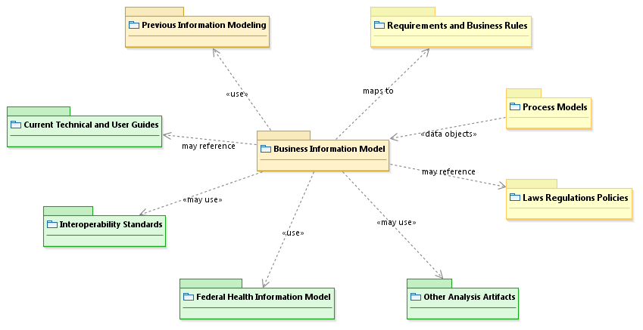
VHA Business Information Modeling Influences
Notes:
This is for display/discussion purposes only. It is not an architecture product.
Tan = BIA Content
Yellow = Business or business-derived content
Green = Content external to business (technical, interoperability, etc.)

Slide 9
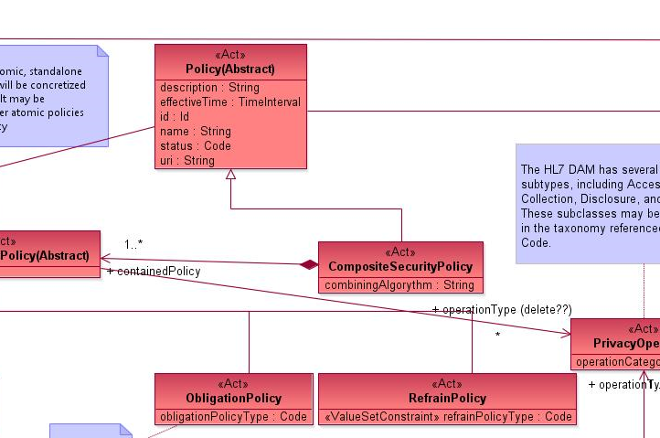
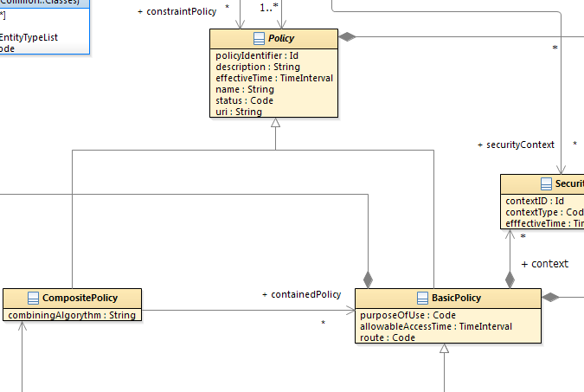
VHA Business Information Modeling Influences How is the FHIM leveraged
FHIM Privacy Domain
VHA Security and Privacy Domain
If the Information Domain under consideration has already been modeled in the FHIM, BIA evaluates the FHIM content for potential matches to VHA information classes. In the above example VHA carefully considered the FHIM Privacy Domain as part of its Security and Privacy work that was performed as part of its iEHR requirements.

Slide 10
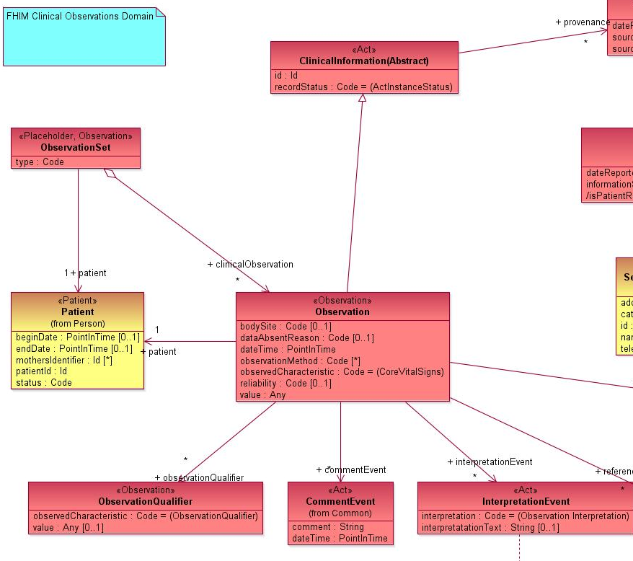
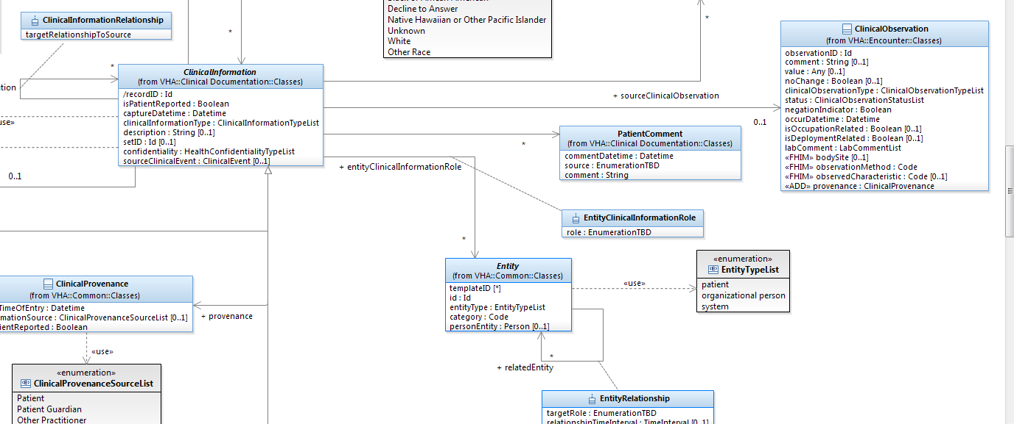
VHA Business Information Modeling Influences How is the FHIM leveraged (Contd)
FHIM Observation Domain
VHA Clinical Observations
In the above example VHA carefully considered the FHIM Observation information pattern as part of its Patient Health Record work that was performed to support multiple VHA work efforts.

Slide 11
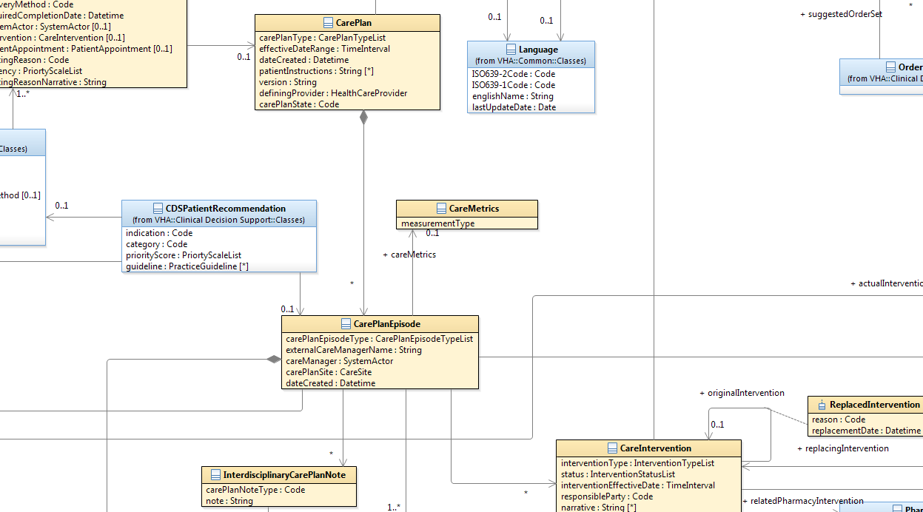
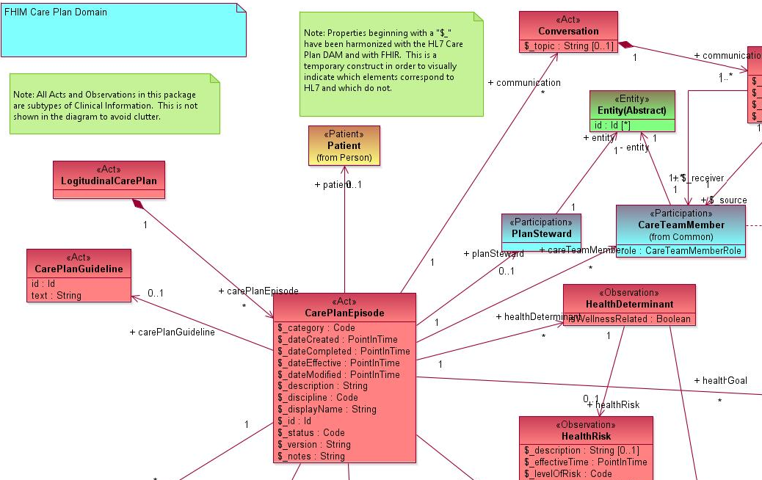
VHA Business Information Modeling Influences How BIA has informed the FHIM
VHA Care Management Domain
FHIM CarePlan Domain
If the Information Domain under consideration was first elaborated by BIA prior to the FHIM, BIA recommends content for potential inclusion in the FHIM model. In the above example VHA had already modeled Care planning during the Care and Disease Management iEHR IPT and provided certain key concepts to the FHIM that was included as part of the FHIM CarePlan domain.

Slide 12
The VHA and FHIM Relationship (In a nutshell)
The VHA prefers to leverage FHIM definitions and attributes when they are in alignment with VHA business information requirements.
The FHIM is usually the first information standard referenced as background work prior to doing any new information modeling activity within a VHA work effort.
The VHA will extend FHIM classes as necessary to accomplish VHA work efforts
Note: Class or attributes may not always perfectly align with FHIM names if the VHA business prefers a name that aligns to the VHA business use.
All necessary changes are communicated back to the FHIM developers when the FHIM concentrates on those particular information domains.
Business Information Architects are regular contributors to the FHIM information modeling work efforts and provide VHA insight into the FHIM design

Slide 13
Questions?
Thank you for your time!

Slide 14
Backup Slides

Slide 15
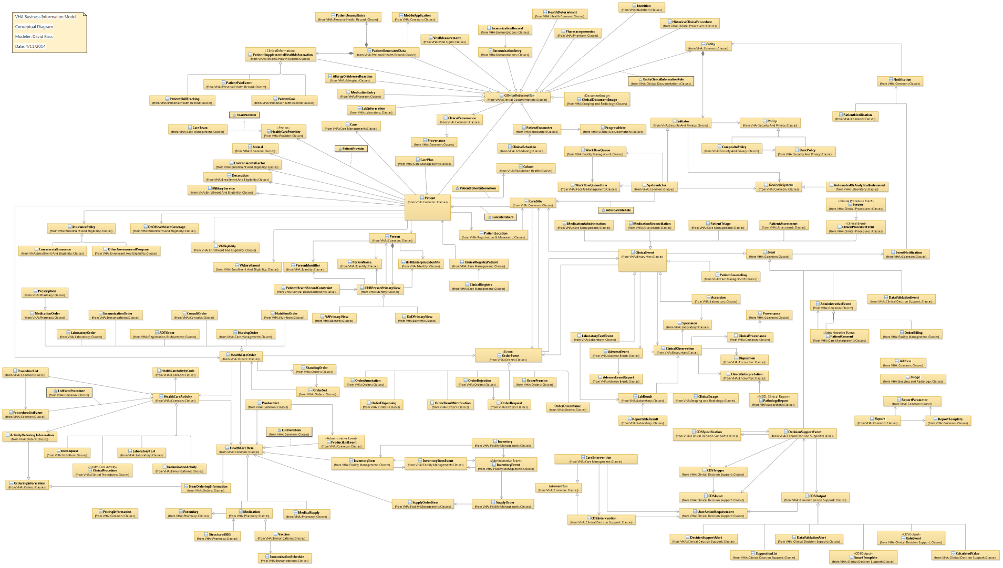
VHA BIM Conceptual Information Model Diagram

Slide 16
Business Information Modeling “Line of Sight”
Business Architecture vision includes creating business information architecture products that are reused in the product development lifecycle to:
“Bind” standard terminology to business concepts
“Extend” the VHA BIM content to support detailed clinical models where desired
“Constrain” BIM content as appropriate to support interoperability requirements
“Generate” platform-specific models needed to support technical solutions, including information exchange specifications
These actions would provide a line of sight from the business information requirements originally vetted with business owners and SMEs to the implemented solutions.

Slide 17
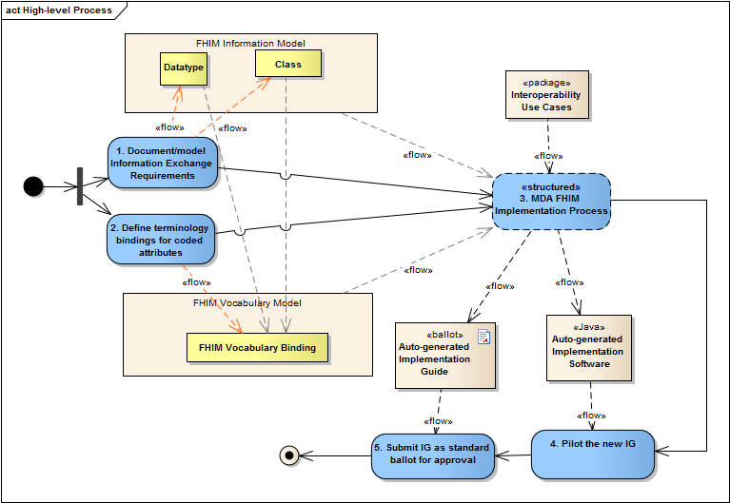
FHIM Model-Driven Architecture Process
Source: FHIM MDA Implementation Modeling Process Guide, Version 0.1

